Slide 1
Access 2016 Module 8
Analyzing Data with Reports

Slide 2
Module Objectives
Use Report Design View
Create parameter reports
Apply conditional formatting
Add lines
Use the Format Painter and themes
Add subreports
Modify section properties
Create summary reports

Slide 3
Use Report Design View (Slide 1 of 3)
Reports give you more control over how data is printed and greater flexibility in presenting summary information.
Report Design View allows you to work with a complete range of report, section, and control properties.

Slide 4
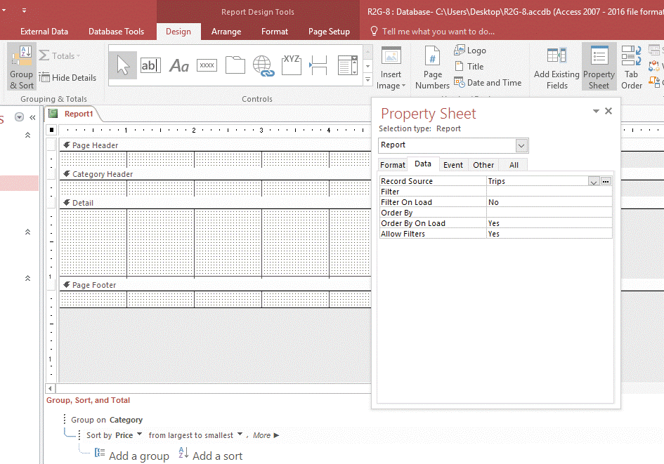
Use Report Design View (Slide 2 of 3)
Creating a report in Report Design View

Slide 5
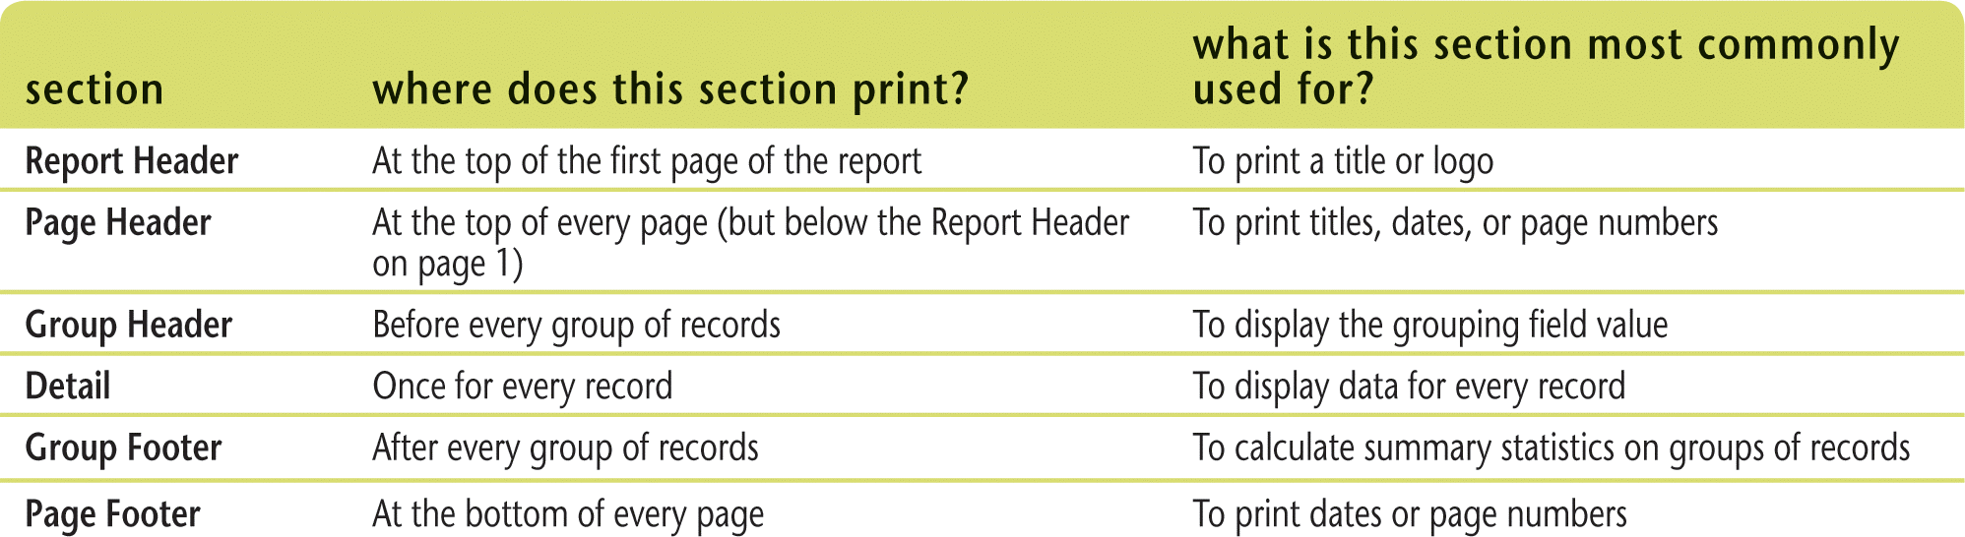
Use Report Design View (Slide 3 of 3)
Review of report sections

Slide 6
Create Parameter Reports (Slide 1 of 2)
Parameter report prompts for criteria to determine the records to use for report
To create a parameter report, base it on a parameter query
Report’s Record Source property determines what table or query provides the fields and records for the report

Slide 7
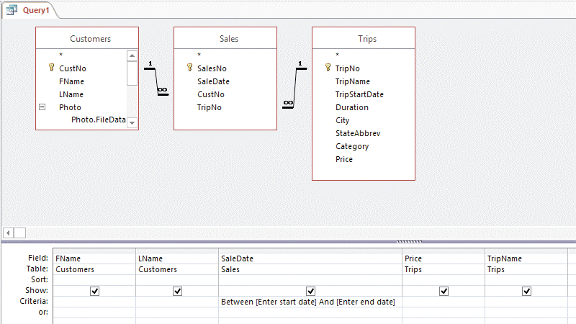
Create Parameter Reports (Slide 2 of 2)
Entering parameter criteria in a query

Slide 8
Apply Conditional Formatting (Slide 1 of 2)
Conditional formatting
change the appearance of a control on a form or report based on specified criteria
Conditional formatting highlights important or exceptional data on a form or report

Slide 9
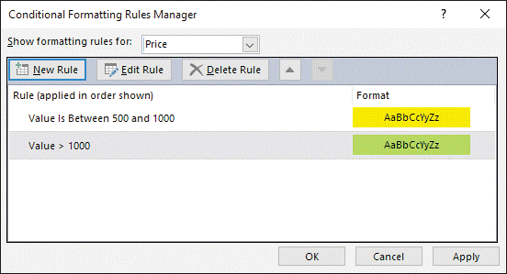
Apply Conditional Formatting (Slide 2 of 2)
Conditional Formatting Rules Manager dialog box

Slide 10
Add Lines (Slide 1 of 2)
Lines often added to a report to highlight or enhance the clarity of information
Can use short lines to indicate subtotals and grand totals

Slide 11
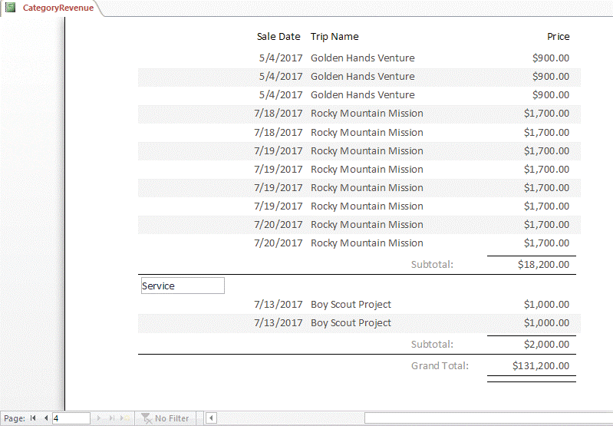
Add Lines (Slide 2 of 2)
Previewing the last page of the CategoryRevenue report

Slide 12
Use the Format Painter and Themes (Slide 1 of 2)
Format Painter
Tool you use to copy multiple formatting properties from one control to another in Design or Layout View for forms and reports
Themes
Predefined formats that you apply to the database to set all of the formatting enhancements such as font, color, and alignment on all forms and reports

Slide 13
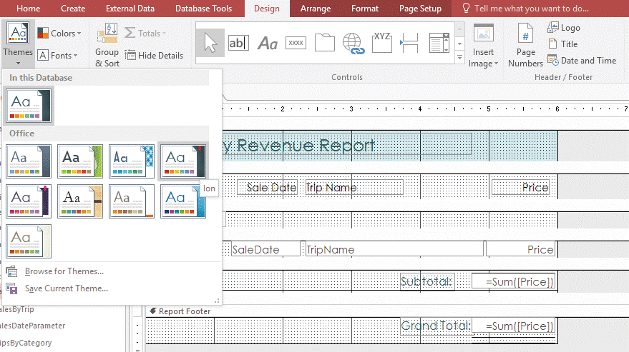
Use the Format Painter and Themes (Slide 2 of 2)
Applying a theme to a report

Slide 14
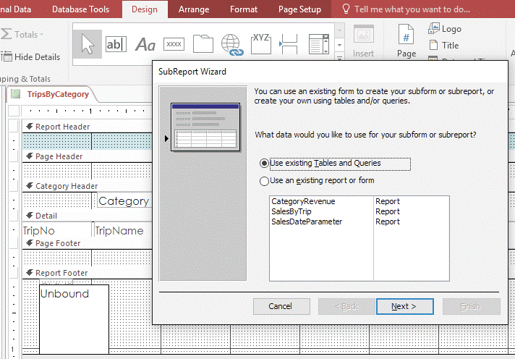
Add Subreports (Slide 1 of 2)
Subreport control displays a report within another report
Report that contains the subreport control is called the main report
Can use a subreport control when you want to connect two reports together
SubReport Wizard dialog box

Slide 15
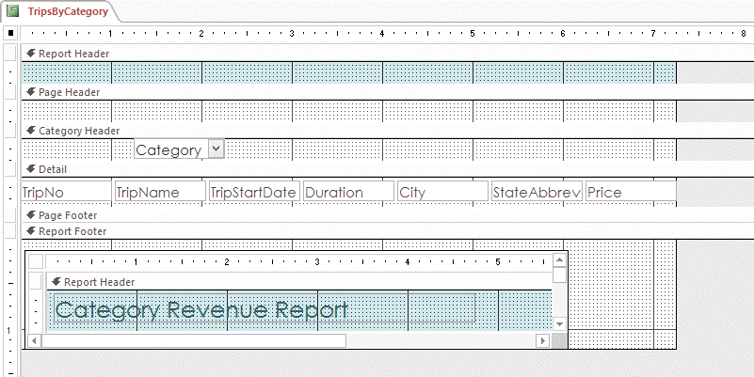
Add Subreports (Slide 2 of 2)
Subreport in Report Design View

Slide 16
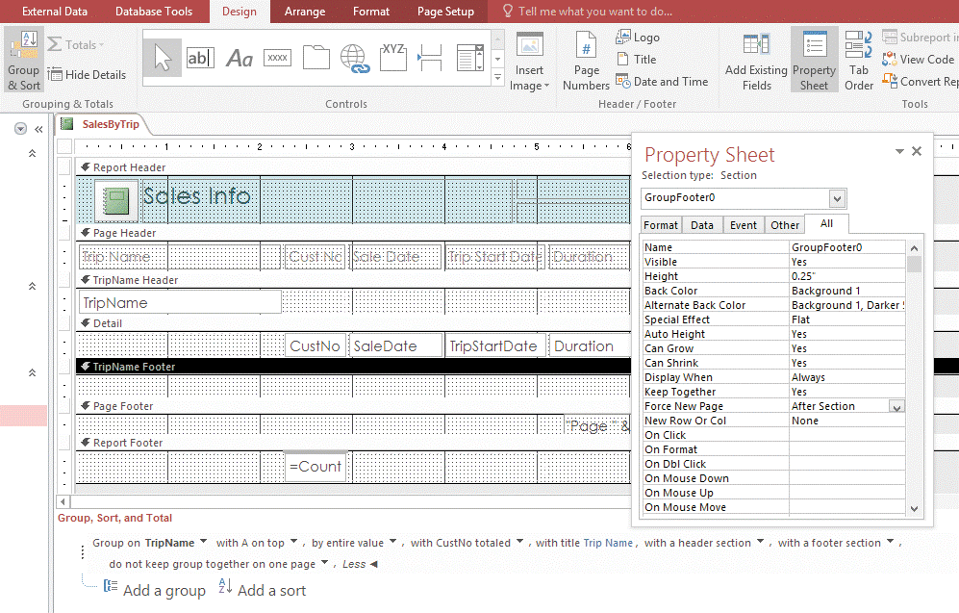
Modify Section Properties
Report section properties
Characteristics that define each section
Can be modified to improve report printouts

Slide 17
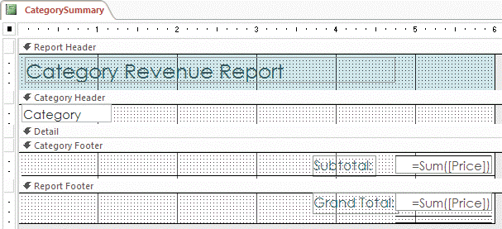
Create Summary Reports (Slide 1 of 2)
Summary reports
Reports that show statistics on groups of records rather than details for each record
Create summary reports by using functions such as Sum, Count, or Avg
Do not contain controls in Detail section
Design View of CategorySummary report

Slide 18
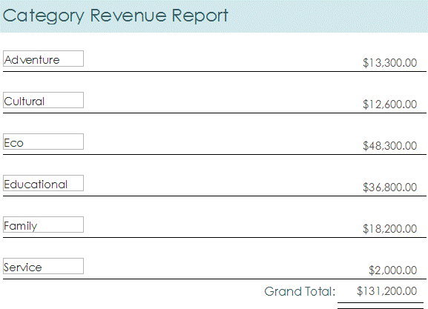
Create Summary Reports (Slide 2 of 2)
Preview of the CategorySummary report

